Slide 1
Stripe Density, Births, and Deaths

Slide 2
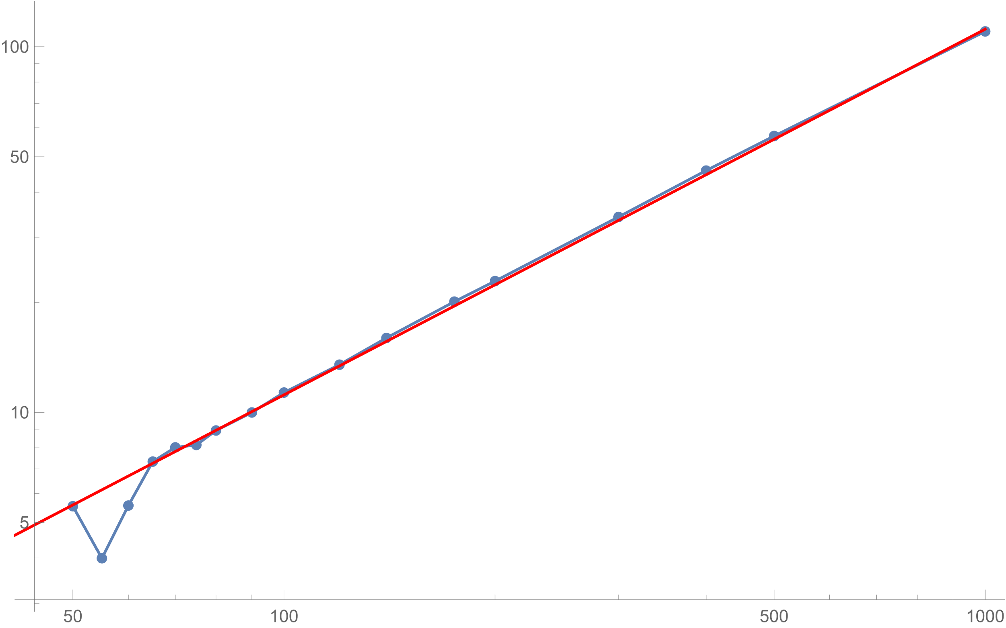
Number of Stripes
$$y=\text{0.11162 }\text{x}$$
Length

Slide 3
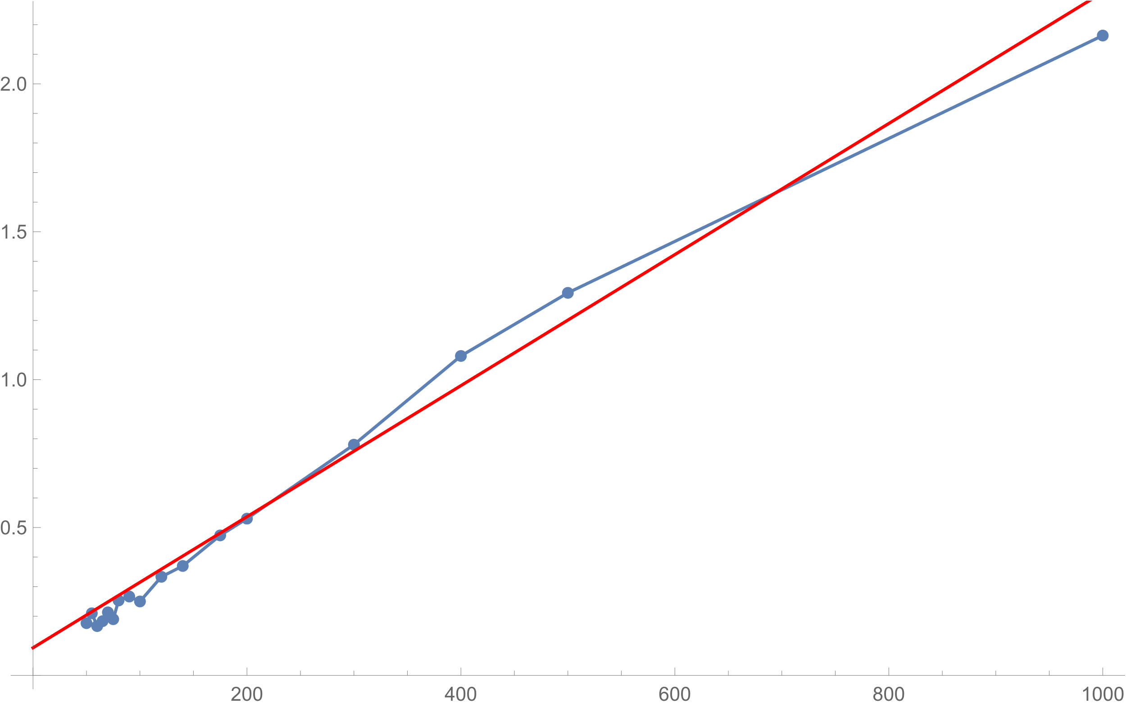
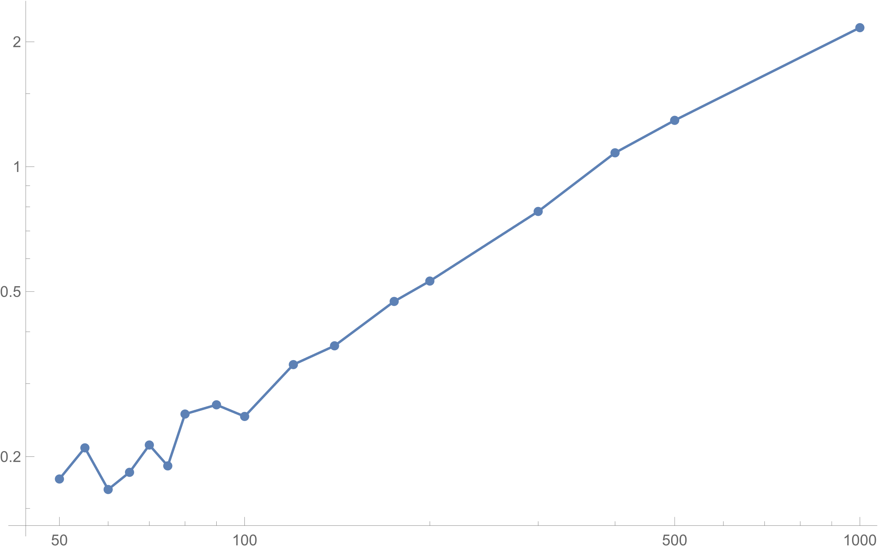
Double-Log
Linear
Stripe Birth Rate
$$\text{0.0933155 +0.00221584 }\text{x}$$
Length
Length

Slide 4
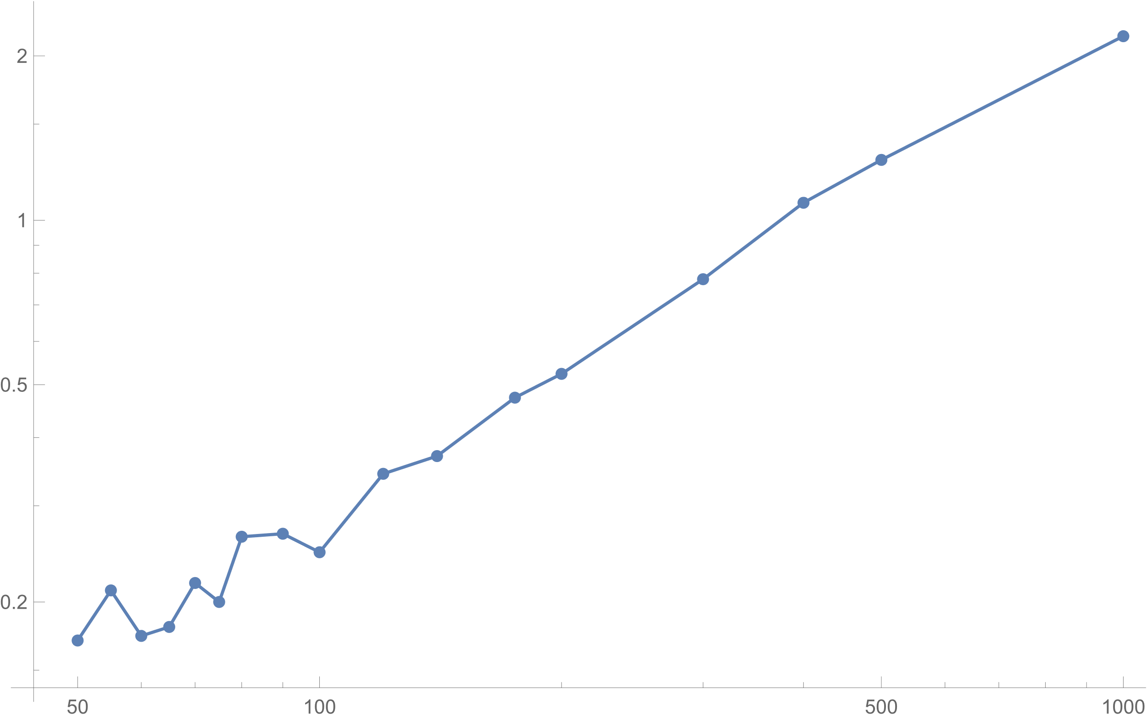
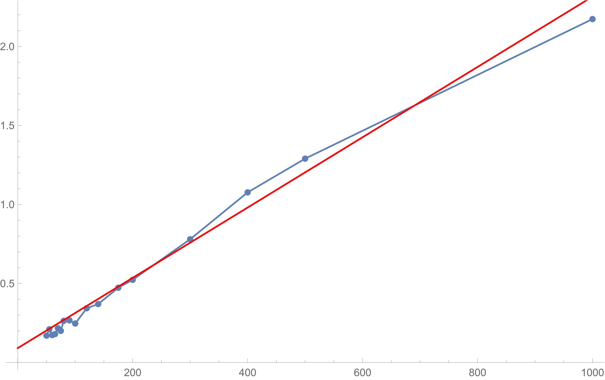
Double-Log
Linear
Stripe Death Rate
$$\text{0.0909847 +0.00222412 }\text{x}$$
Length
Length

